Slide 1

VoltSphere - Seamless EV Power Grid
Kishan Gupta -23107066
Hemanshu Ingale-23107077
Shardul Kadam-23107068
Parth Pawar- 23107048
Project Guide
Ms. Veena Trivedi Mam

Slide 2
Contents
Introduction
Objectives
Scope
Features / Functionality
Project Outcomes
Technology Stack
Block Diagram if applicable

Slide 3
1. Introduction
Problem Identified :
EV owners face difficulty in finding available charging stations.
No proper slot management system, leading to long wait times.
Lack of priority booking for emergency charging.
Solution Proposed :
A desktop application for booking and managing EV charging slots.
Real-time slot availability with color coding.
Membership-based priority booking system.

Slide 4
2. Objectives
To develop a user-friendly system for booking EV charging slots.
To integrate a priority-based membership system for urgent charging needs.
To generate digital receipts and maintain charging history for users.
4. Color-Coded Slot Status
Green (Available), Red (Booked), Yellow (Reserved for Members).

Slide 5
3. Scope
Can be applied in public EV charging stations.
Useful for EV owners, fleet operators, and charging station managers.
Can be extended for mobile application integration in the future.
Supports both 2-wheeler and 4-wheeler charging at the same station.

Slide 6
4. Feature /Functionality
Feature 1: Slot Booking & Availability
Users can check available slots and book them in advance.
Feature 2: Membership-Based Priority Booking
Premium users get priority access to slots.
Feature 3: Charging History & Invoice
Users can track past charging sessions and download receipts.
Feature 4: Color-Coded Slot Status
Green (Available), Red (Booked), Yellow (Reserved for Members).

Slide 7
5. Outcome of Project
Users can log in and access a personalized dashboard.
Users can search and locate nearby charging stations.
Users can book, modify, or cancel charging slots as per availability.
Membership users get priority-based slot allocation.
Users receive invoices and track charging history for future reference.

Slide 8
6. Technology Stack
Frontend: Python (Tkinter)
Backend: MySQL Database
Libraries: Pandas, Matplotlib (for analytics), ReportLab (for invoice generation)

Slide 9
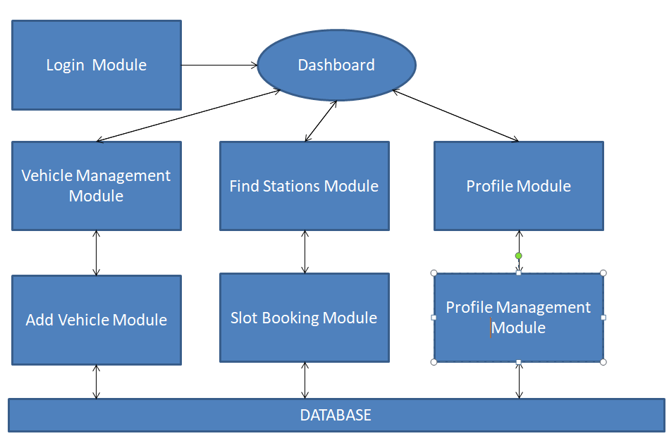
7. Block Diagram

Slide 10
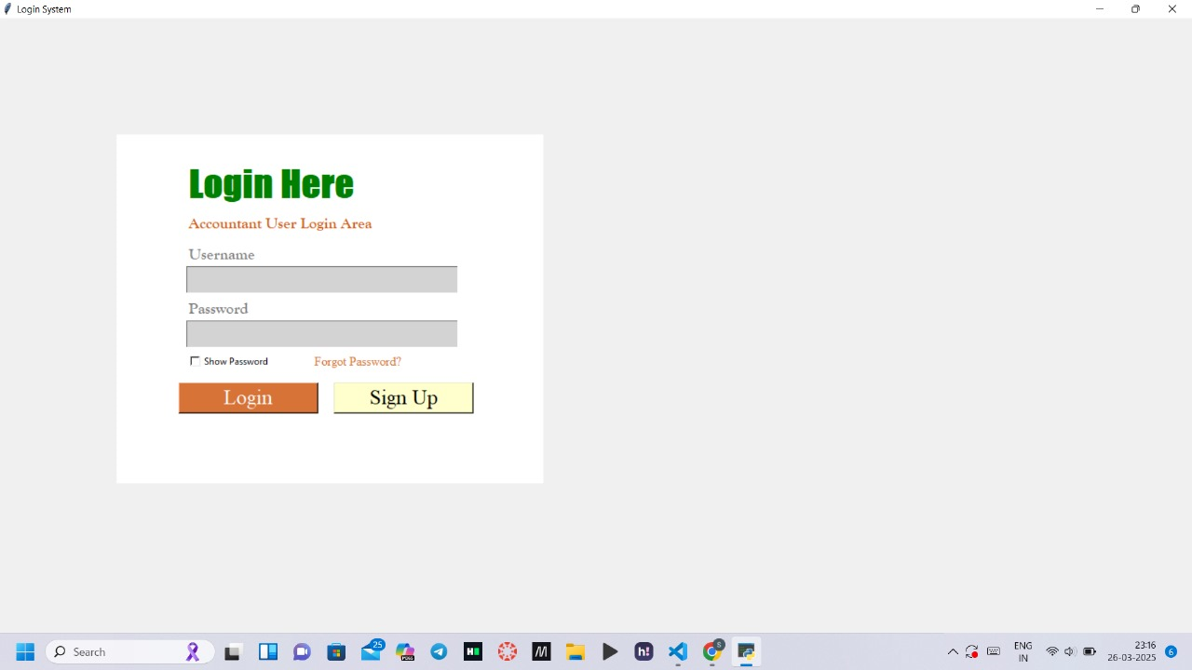

Slide 11
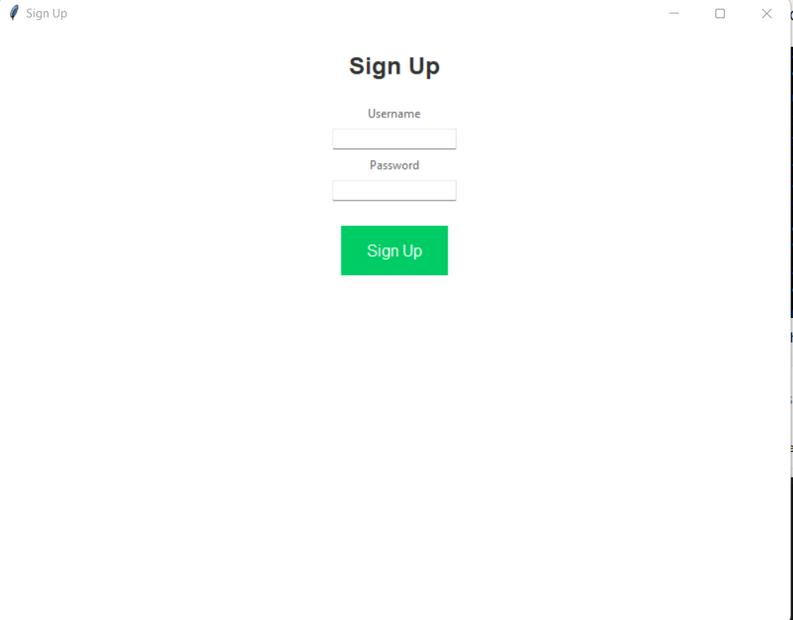

Slide 12
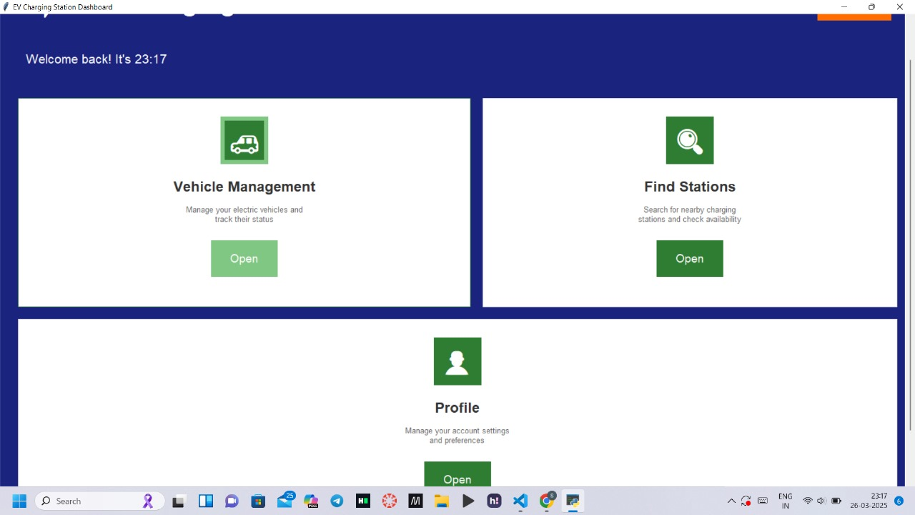

Slide 13
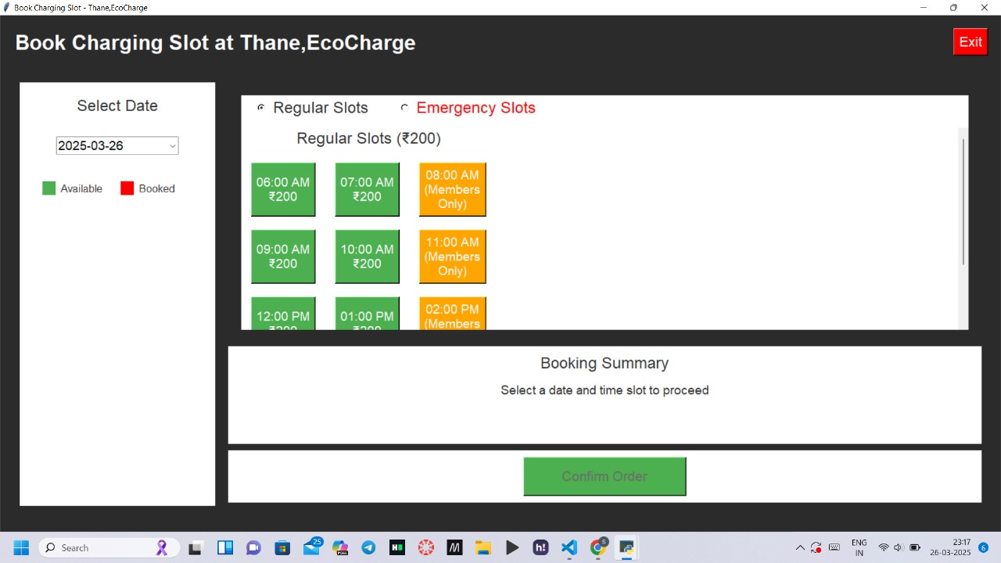

Slide 14
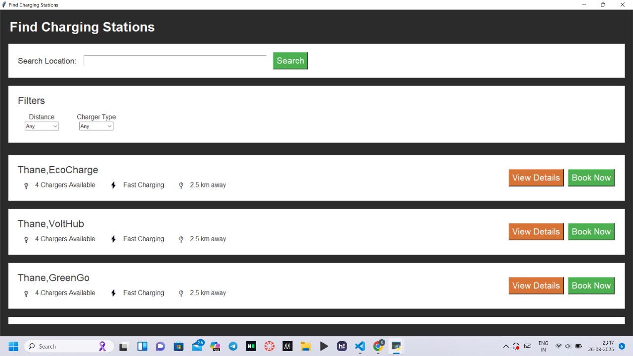

Slide 15
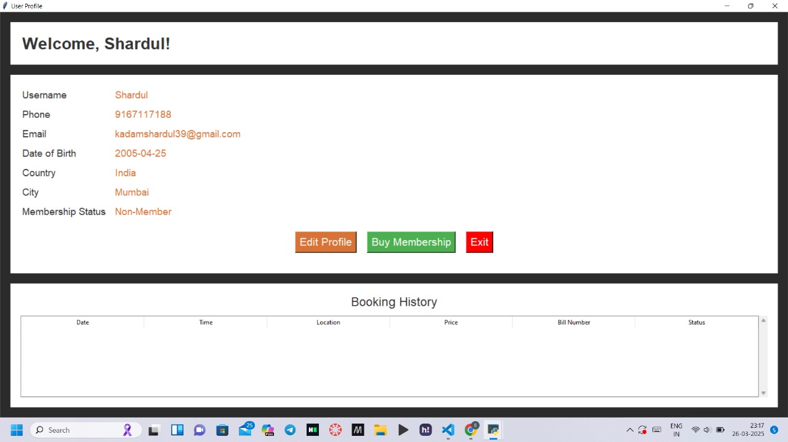

Slide 17
Thank You...!!

